Slide 1


Modern Man hits the scene

Slide 2
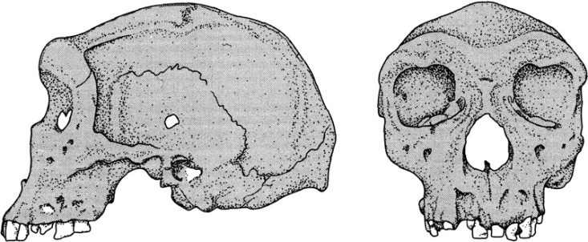
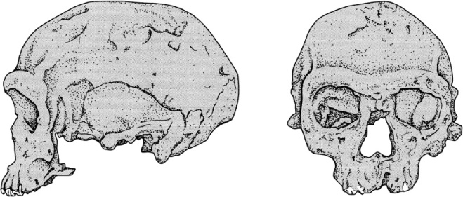
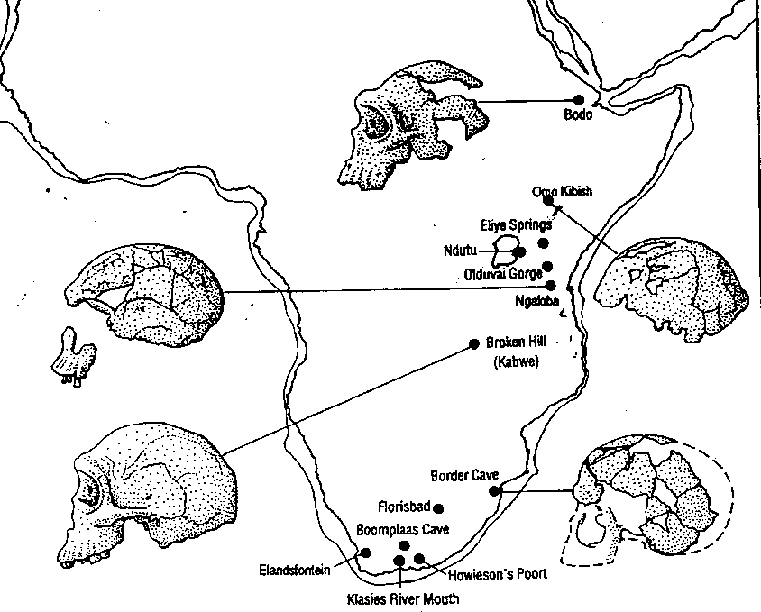
After Homo erectus in Africa
Kabwe
As well as the Kabwe cranium which is of uncertain date, but older than 200ky, there are a number of other similarly archaic fossils (see map: Elandsfontein, Bodo, Ndutu). These fossils are often grouped into Homo heidelbergensis because of their overall similarity with European finds such as Petralona.
In Africa there is then a slightly later group of fossils, including Jebel Irhoud (bottom) which appear to be more modern in character. These include the finds from Florisbad, Ngaloba, Koobi Fora and Omo II (see map). It isn’t clear whether these should be included in H. heidelbergensis, put into a separate species or considered to be very early H. sapiens.
Jebel Irhoud
Drawings from Lewin & Foley (2003)
Map from Stringer & Gamble (1993) In Search of the Neanderthals. Thames & Hudson

Slide 3
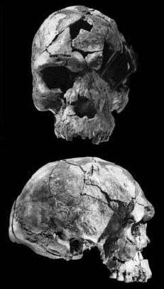
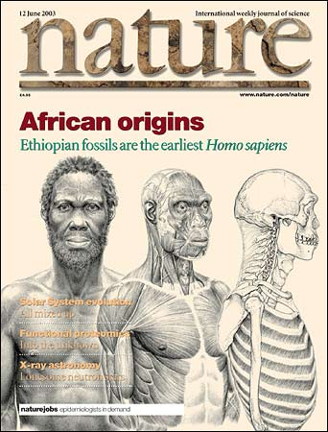
The finds from Ethiopia (2003)
The overall appearance of the cranium is “modern.” It is more like us than it is like earlier, more archaic African examples of Homo heidelbergensis. Also, it certainly isn’t like its European contemporaries, the Neanderthals.
It falls slightly outside the modern human range. Given the date of 160,000 to 154,000 bp, these differences are not that surprising. This find strengthens the evidence for modern human emergence in Africa.
Called Homo idaltu
The most complete cranium. This is large and robust with a cranial capacity estimated at 1450 cm³ .
White et al (2003) Pleistocene Homo sapiens from Middle Awash, Ethiopia. Nature 423 742-747

Slide 4
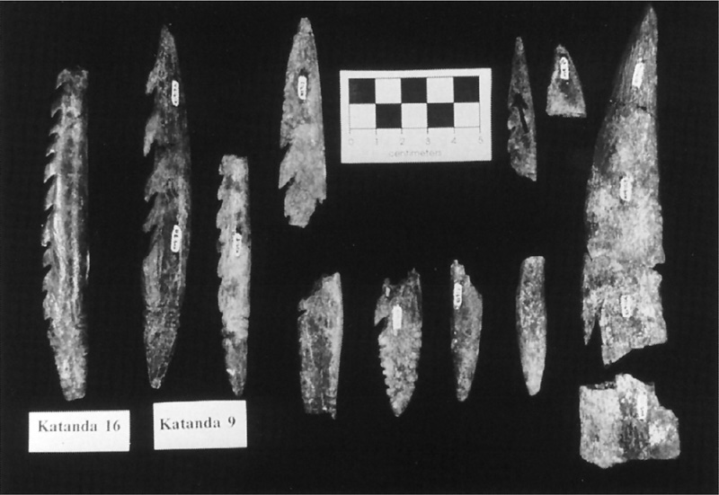
Some examples of early “modern” behaviour in Africa - 1
These Middle Stone Age bone tools from the Democratic Republic of the Congo are the earliest known examples of worked bone, dated between 90ky and 160ky (courtesy of Alison Brooks & John Yellen). From Lewin & Foley (2003) Figure 16.10

Slide 5
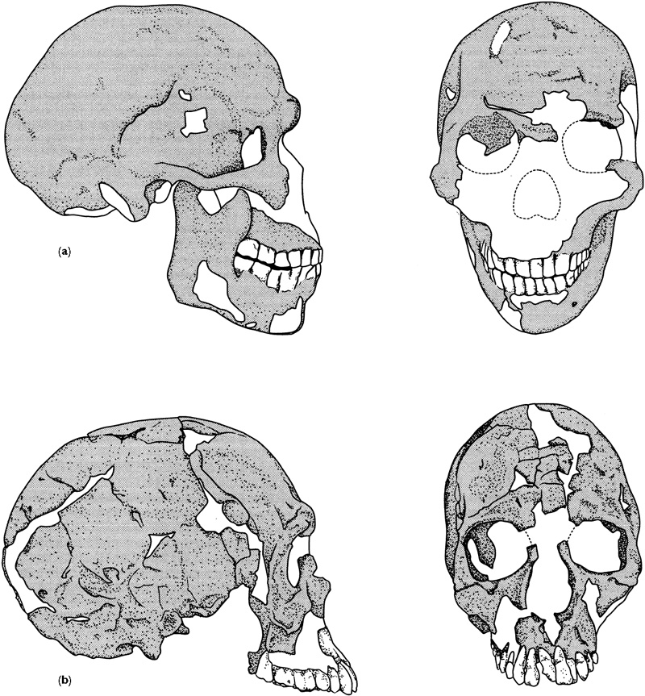
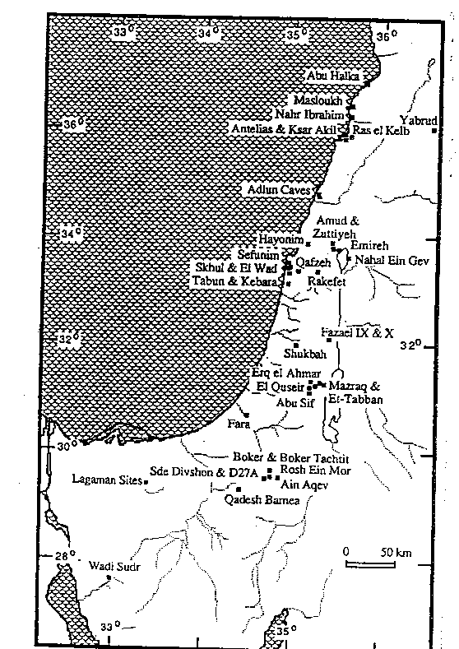
Early modern humans in the Levant
These two crania, Skhul (top) and Qafzeh (bottom) are still robustly built but have a more modern shape – the cranium is rounded, the face is smaller and tucked in under the cranium and the lower jaw has a chin. Now dated to 100ky they are the earliest known specimens of H. sapiens outside Africa.
Map of the Levant from Klein (1999)
Lewin & Foley (2003) Figure 14.8

Slide 6
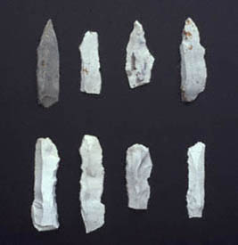
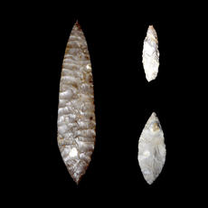
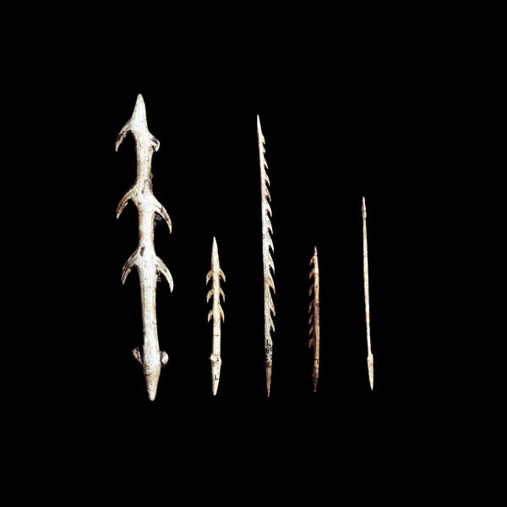
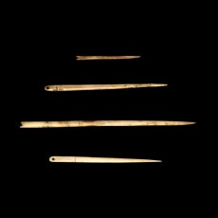
Finely made tools
From 50,000 years ago we
find the stone tool
industries of the Upper
Palaeolithic. These are
characterised by
the use of blades.
They are associated with
modern humans.
In addition there is extensive use of bone and antler for making a diverse range of tools from needles to harpoons.

Slide 7
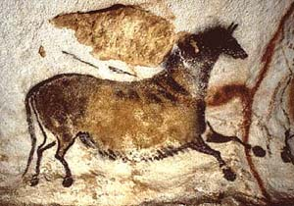
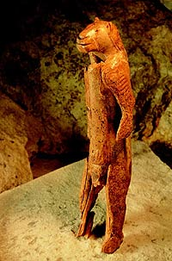
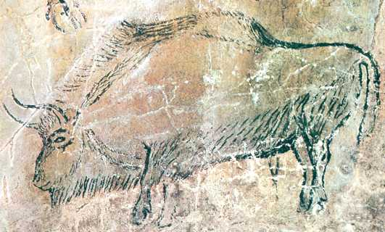
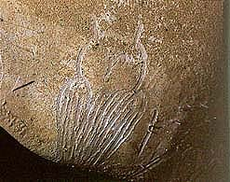
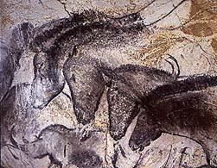
Ice Age Art in Europe Cro-Magnon man
Niaux Cave
Lascaux Cave
Made from mammoth ivory approx 32,000 years ago, this small statuette was found in a cave, the Hohlenstein-Stadel in the Swabian Alps (Southern Germany).
The panel of horses and a little owl from Chauvet cave

Slide 8
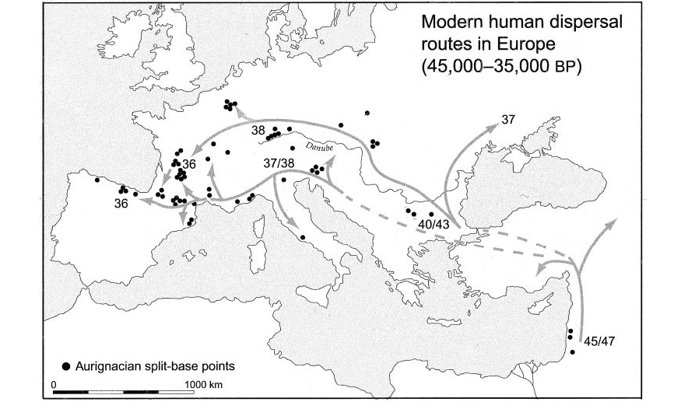
Apparent dispersal routes of the earliest anatomically and behaviorally modern populations across Europe, as reflected in the archeological data
The northern (Danubian) route is represented by the “classic” Aurignacian (Upper Palaeolithic) technologies, while the southern (Mediterranean) route is represented by different but still Upper Palaeolithic bladelet technologies with their inferred origins in the preceding early Upper Paleolithic technologies in the Near East and southeastern Europe.
Dates indicate the earliest radiocarbon dates for these technologies in different areas, expressed in thousands of radiocarbon years BP. (Note that these are likely to underestimate the true (calendrical) ages of the sites by between 2,000 and 4,000 years.)
From: Mellars, P. (2005) Evolutionary Anthropology 14:12–27

Slide 9
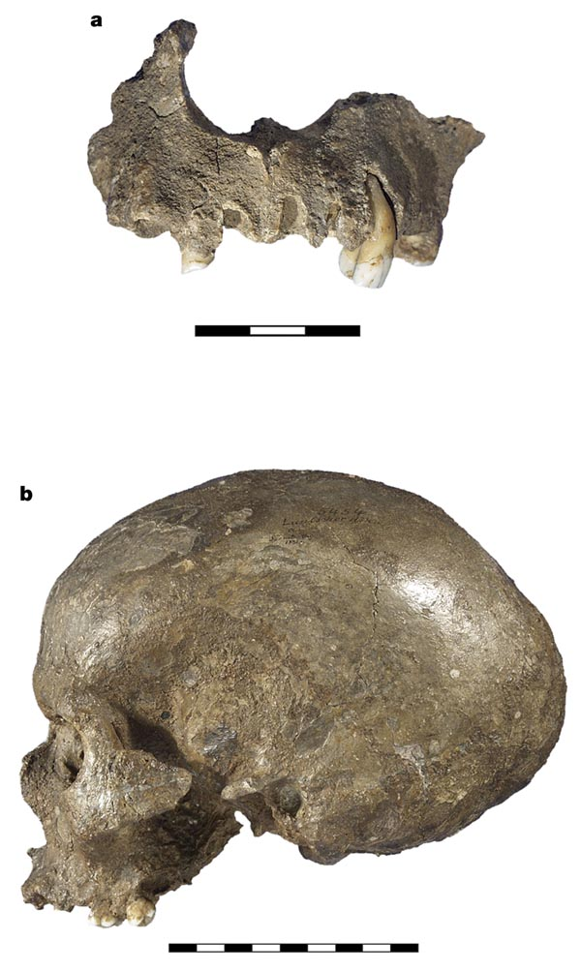
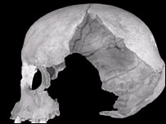
The appearance of the first modern humans in Europe
Early modern from the Peştera Muierii, Baia de Fier, Romania.
Dated to c. 30kya (radiocarbon years) or c. 35,000 cal years BP (Soficaru et al, 2006)
Early modern from Mladec; recently dated to c. 30kya (radiocarbon years) –Wild et al (2005) Nature 435, 332-335.
NB no Neanderthal mtDNA found (Serre et al (2004)
“We've known for some time that the earliest modern humans in Europe are a funny-looking bunch”
Professor Clive Gamble

Slide 10
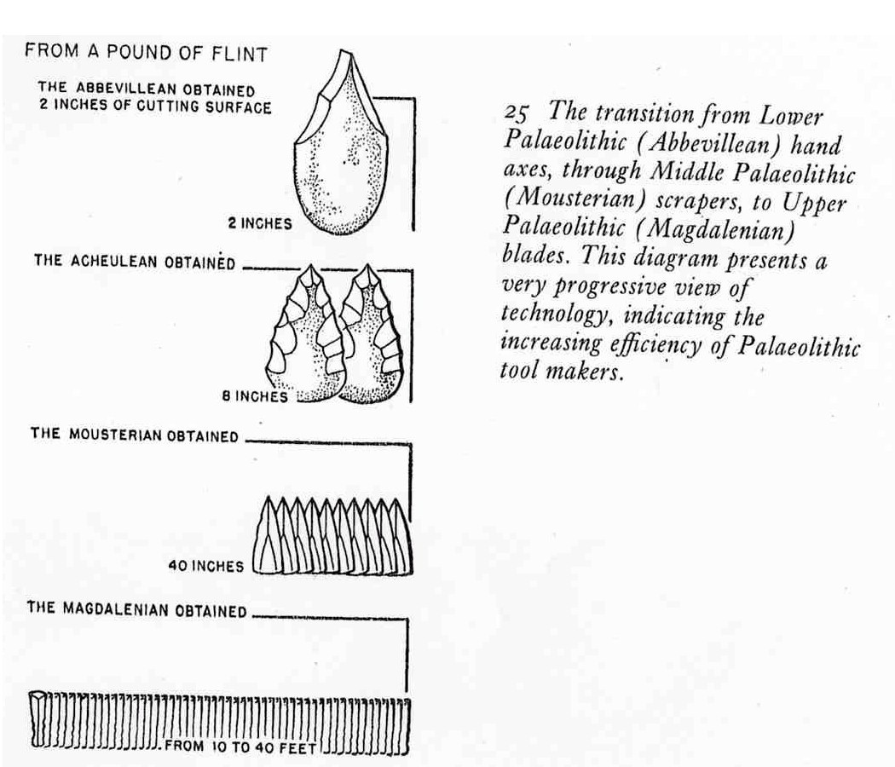
Inferences from tools – 1: Efficiency of use of raw material.
From Stringer & Gamble (1993)

Slide 11
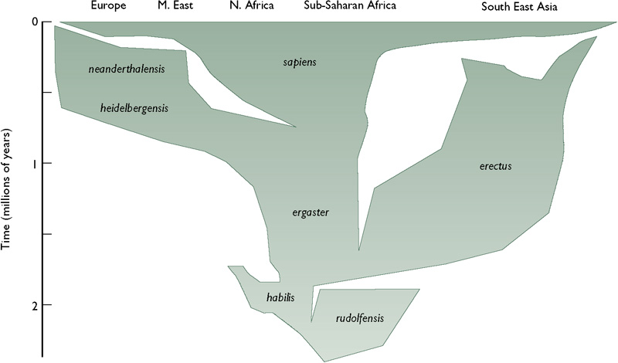
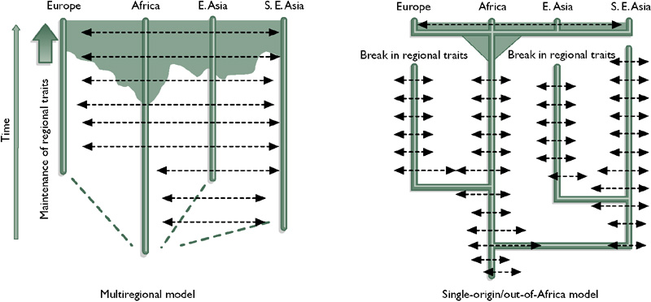
Out of Africa, again
While the Neanderthal lineage developed in Europe, a second lineage developed in Africa – our ancestors
There are two contrasting models for modern human origins. The best supported by the fossil evidence is a recent expansion from Africa.

Slide 12
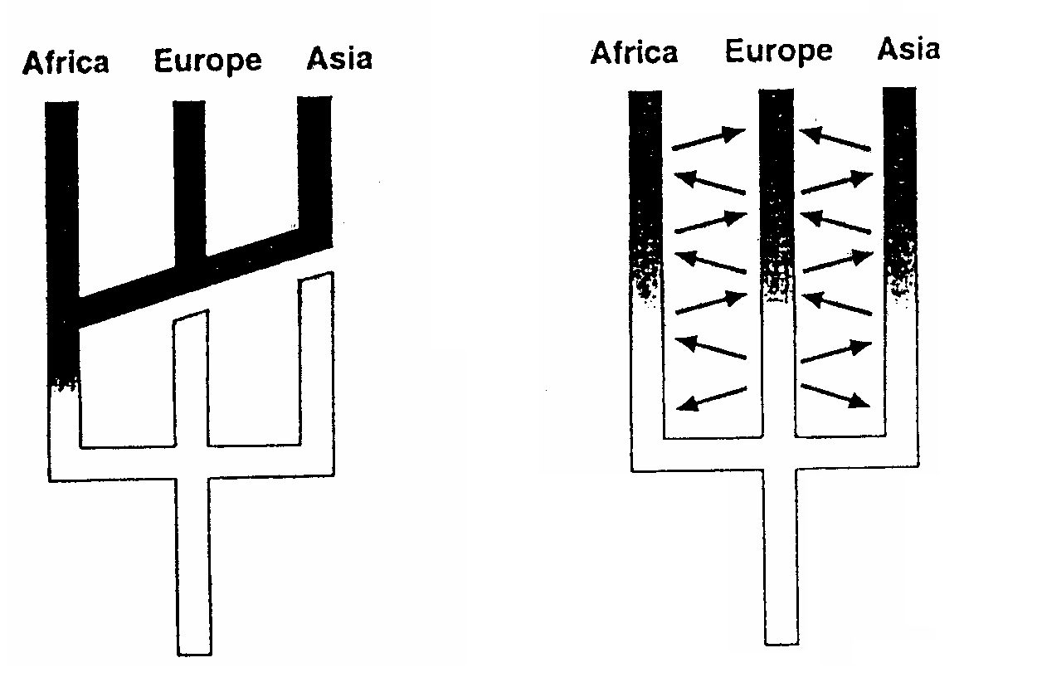
The dispersal of modern man
Replacement model (out of africa)
Multiregional model

Slide 13
Multiregional theory
H. erectus evolved independently into H. sapiens at the same time all around the world
Gene flow between populations was enough to explain uniformity of modern man’s DNA
A Portuguese fossil suggests mix between H.s. and H.n.
Australian fossils supposedly show humans arriving at different times and mixing

Slide 14
Out of Africa theory
Mitochondrial DNA evidence supposedly shows a common ancestor (‘African Eve”’) from Africa about 170,000 years ago.
A ‘genetic divide’ suggests they left Africa about 52,000 years ago.
Chromosomal DNA may indicate migrations out of Africa between 400,000 & 800,000 years ago and also 100,000 years ago.
H. idaltu (modern) was in Africa when Neanderthals were in Europe – before N’s disappeared so could not be descended from N’s.

Slide 15
